Slide 1

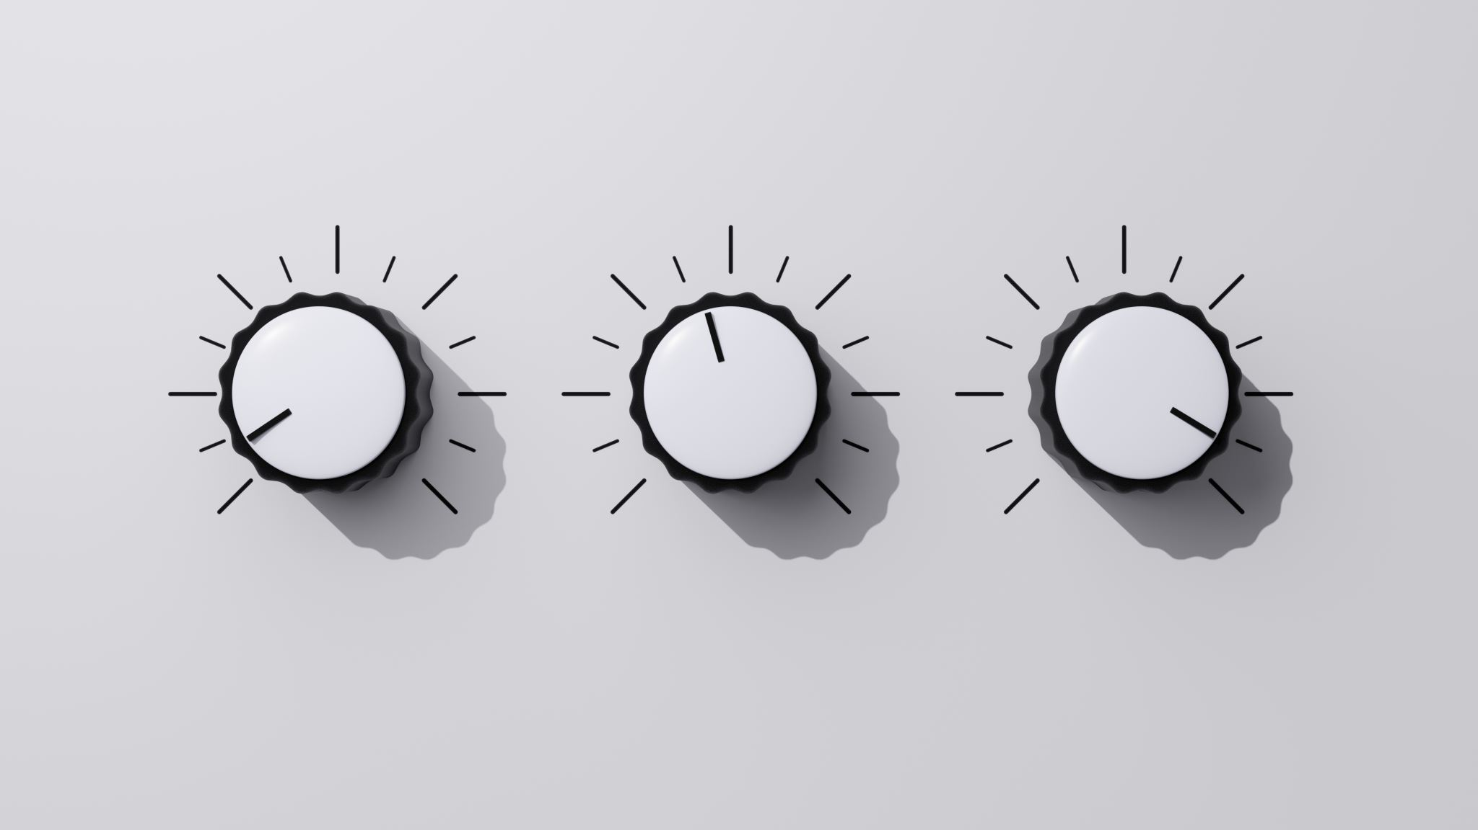
EE-232: Signals and Systems

Slide 2

Introduction
Audio splicing is one of the most common manipulation techniques in the area of audio forensics
Especially after countless breakthroughs in machine learning and deep neural networks, forgery and manipulation in speeches of political figures is highly prevalent and ultimately, detrimental to a productive and functioning society
Although the proposed architecture in this report is not highly accurate, it requires very little computation power to localize splicing in audio

Slide 3

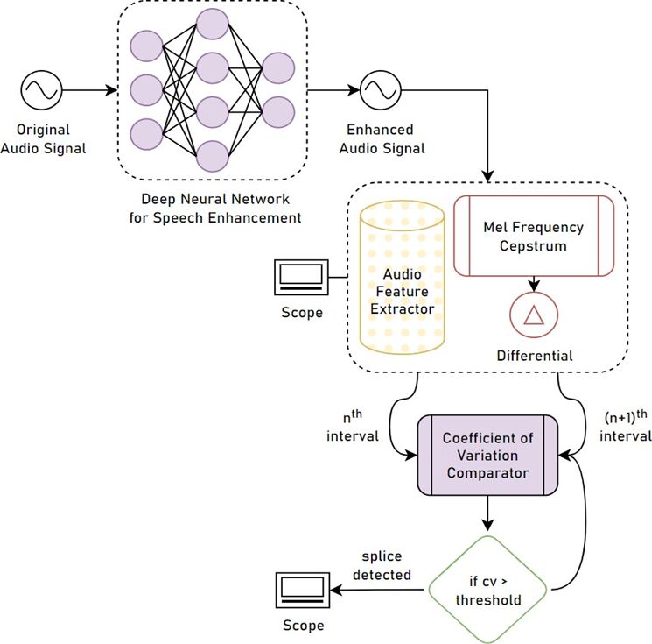
Algorithm Flowchart

Slide 4

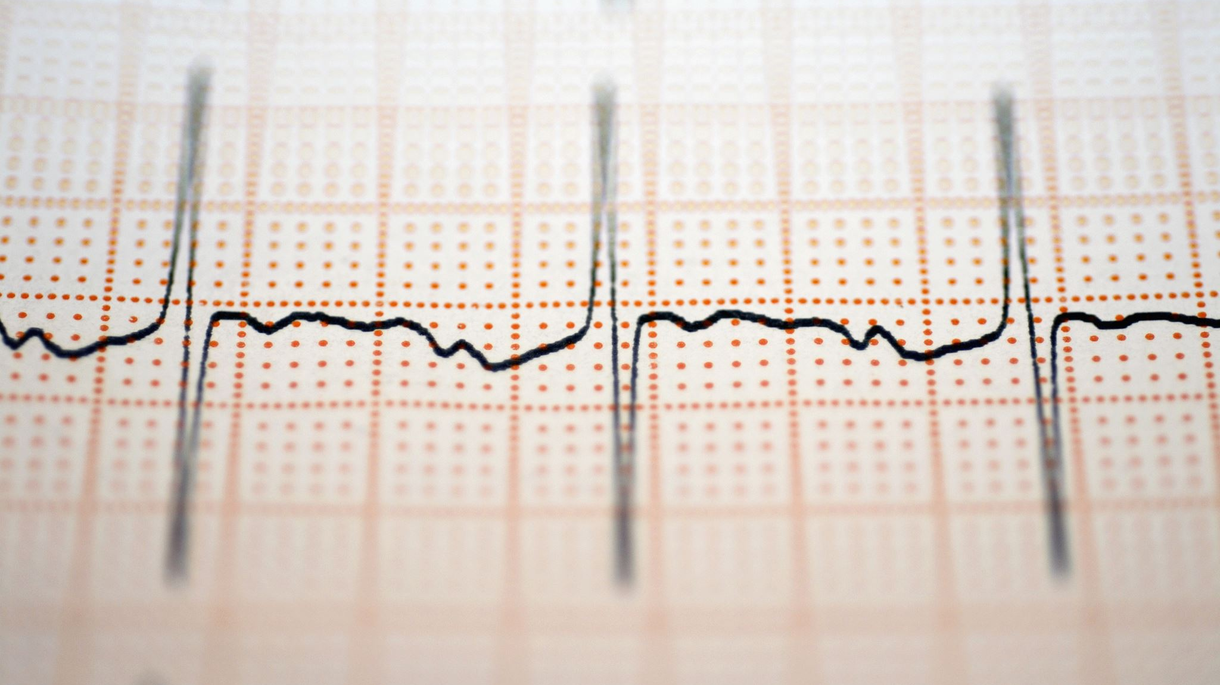
Methodology

Slide 5
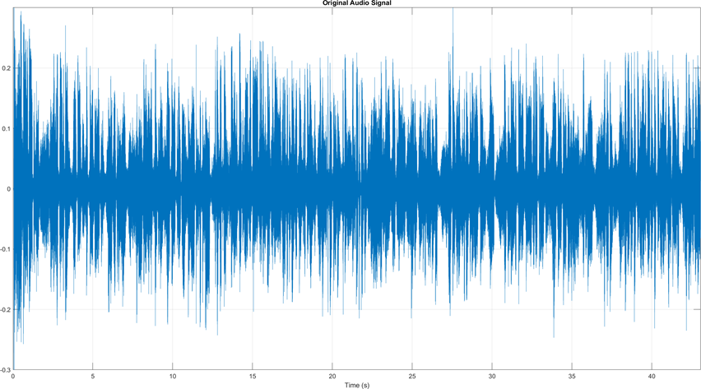
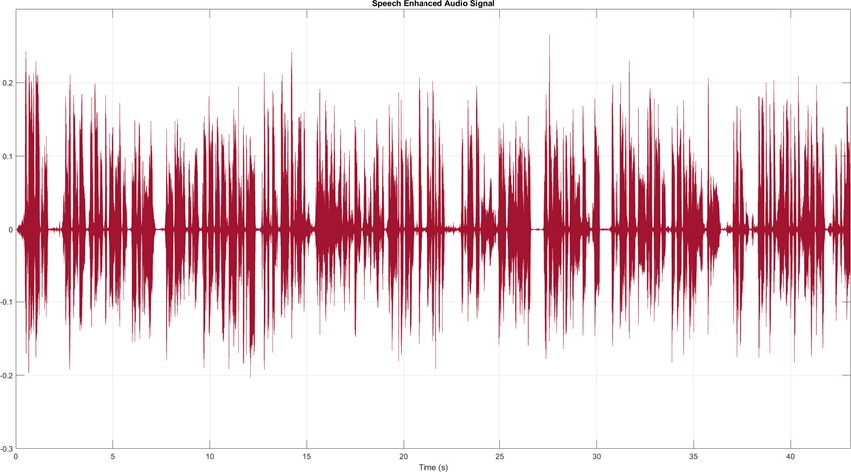
Audio Preprocessing
Audio preprocessing involves splitting and separating the background song from the speech of the speaker
A common way to accomplish this is to plot a Fourier coefficient of the audio signal and find the contributing frequencies of the speech and the audio before applying a thresholding algorithm to split the audio signals

Slide 6
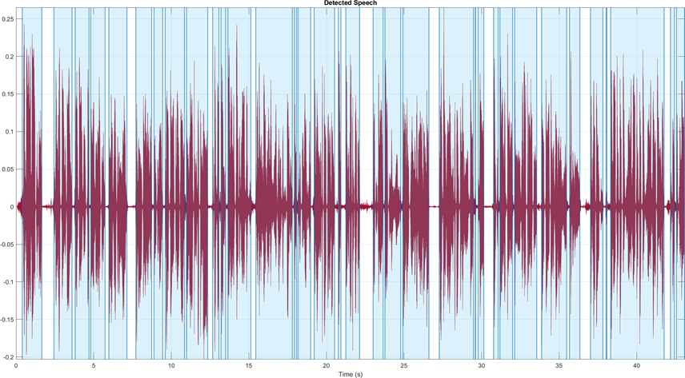
Speech Detection
Audio Toolbox™ add-on of MATLAB® has a built-in function, detectSpeech , to detect all bits of speech in an audio signal
Depending on the window and overlap length arguments passed into the function, the number of speech vectors detected can be increased, which is of our interest
It returns a 𝑛 × 2 matrix; with column one being the starting length of detected speech and column two being the ending length

Slide 7
Audio Feature Extractor
Audio Toolbox™ add-on of MATLAB® has a built-in function, audioFeatureExtracto , for encapsulating multiple audio feature extractors into a streamlined approach
Like detectSpeech , it too relies heavily on window and overlap lengths, and extracting as much of the features in a reasonable amount of vectors is of interest to us
Feature extractors encapsulated include, but are not limited to, linearSpectrum, melSpectrum, barkSpectrum, mfcc, gtcc, pitch, zero-cross rate, spectralEntropy, etc

Slide 8
Mel-frequency cepstrum
In mfc, the frequency bands are equally spaced on the mel-scale, which approximates the human auditory system’s response more closely than the linearly spaced frequency bands used in the normal spectrum
As stated earlier, what we specifically target are the delta features of the mfc, mfccDelta, so as in order to understand the dynamics of power spectrum better, and directly in relation to time
The following subplots shows the plots of mfccDelta for each individual detected speech intervals

Slide 9
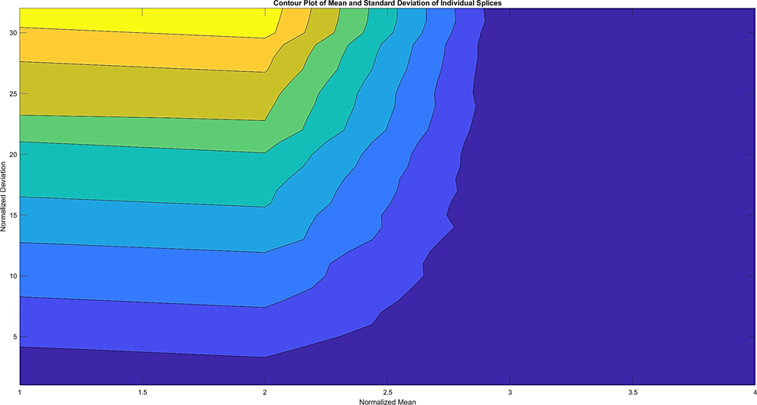
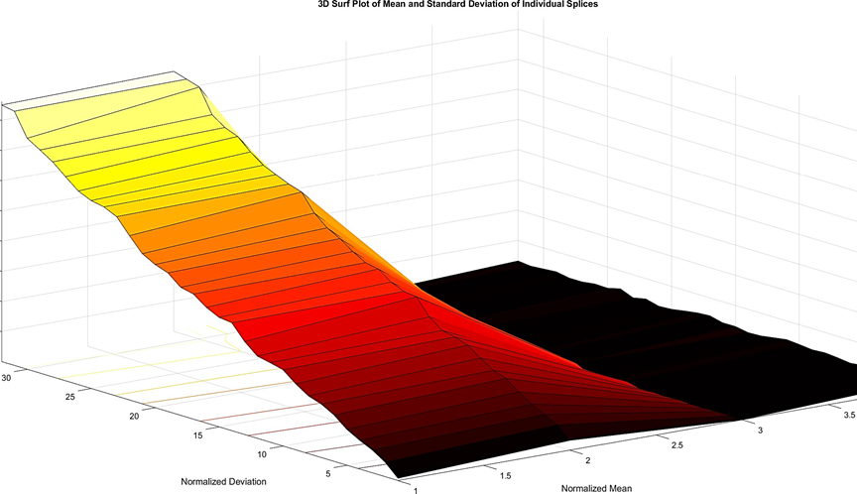
Feature Maps and Relative Statistics
After extracting the mfccDelta vectors of each individual speech interval, a viable measure of comparison should be established for the detection of splices
For that purpose, we draw the contour and surf plots of the normalized mean and standard deviations of the mfccDelta intervals
The coefficient of variation is computed through the following formula: , where 𝜎 is the standard deviation, and 𝜇 is the mean of the interval

Slide 10
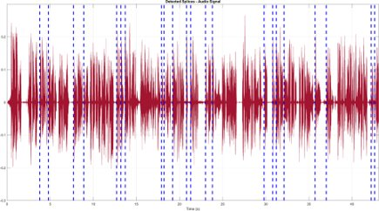
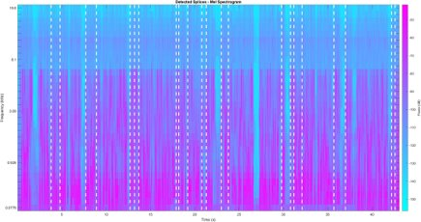
Splice Localization
The final stage of splice detection is localization of the splice on the mel-spectrogram, as well as the audio signal
This can be achieved by marking the starting length of the latter adjacent interval while computing CV as the starting point of the splice
Following results show the located splices in the audio signal

Slide 11
Limitations of Spectrogram-based Splicing Detection
The proposed method currently faces critical limitations in generalization tasks; mel- spectrogram based splicing detection is best suited for audio files that have magnitude correlation coefficient per speech interval near to each other
To counteract this limitation, a dynamic threshold calculator may be trained using large amounts of data, however, training a deep neural network for the sake of splicing detection itself would yield better results if computational power were not limited
Another limitation of spectrogram-based audio splicing detection methods is the presence of unbounded noise

Slide 12
Conclusion
A novel method for audio splicing detection and localization has been proposed
The MATLAB® Audio Toolbox™ offers powerful audio feature extraction pipelines, as well as pre- trained deep learning models for detection of characteristics
The power dynamics of the speech intervals over time were taken into account by differentiating the mel-frequency cepstral coefficients with respect to time and compared by defining a suitable evaluation criterion

